Slide 1


SMART INDIA HACKATHON 2025
STARTUP PUBLIC PROCUREMENT MECHANISM
Problem Statement ID – SIH1742
Problem Statement Title - Startup friendly public procurement mechanism that enables government departments to identify, pilot, procure, and scale innovative solutions from eligible startups
Theme – Smart Governance & Startup Innovation
PS Category- Software
Team ID - SIH:S:062
Team Name - PEGASUS

Slide 2
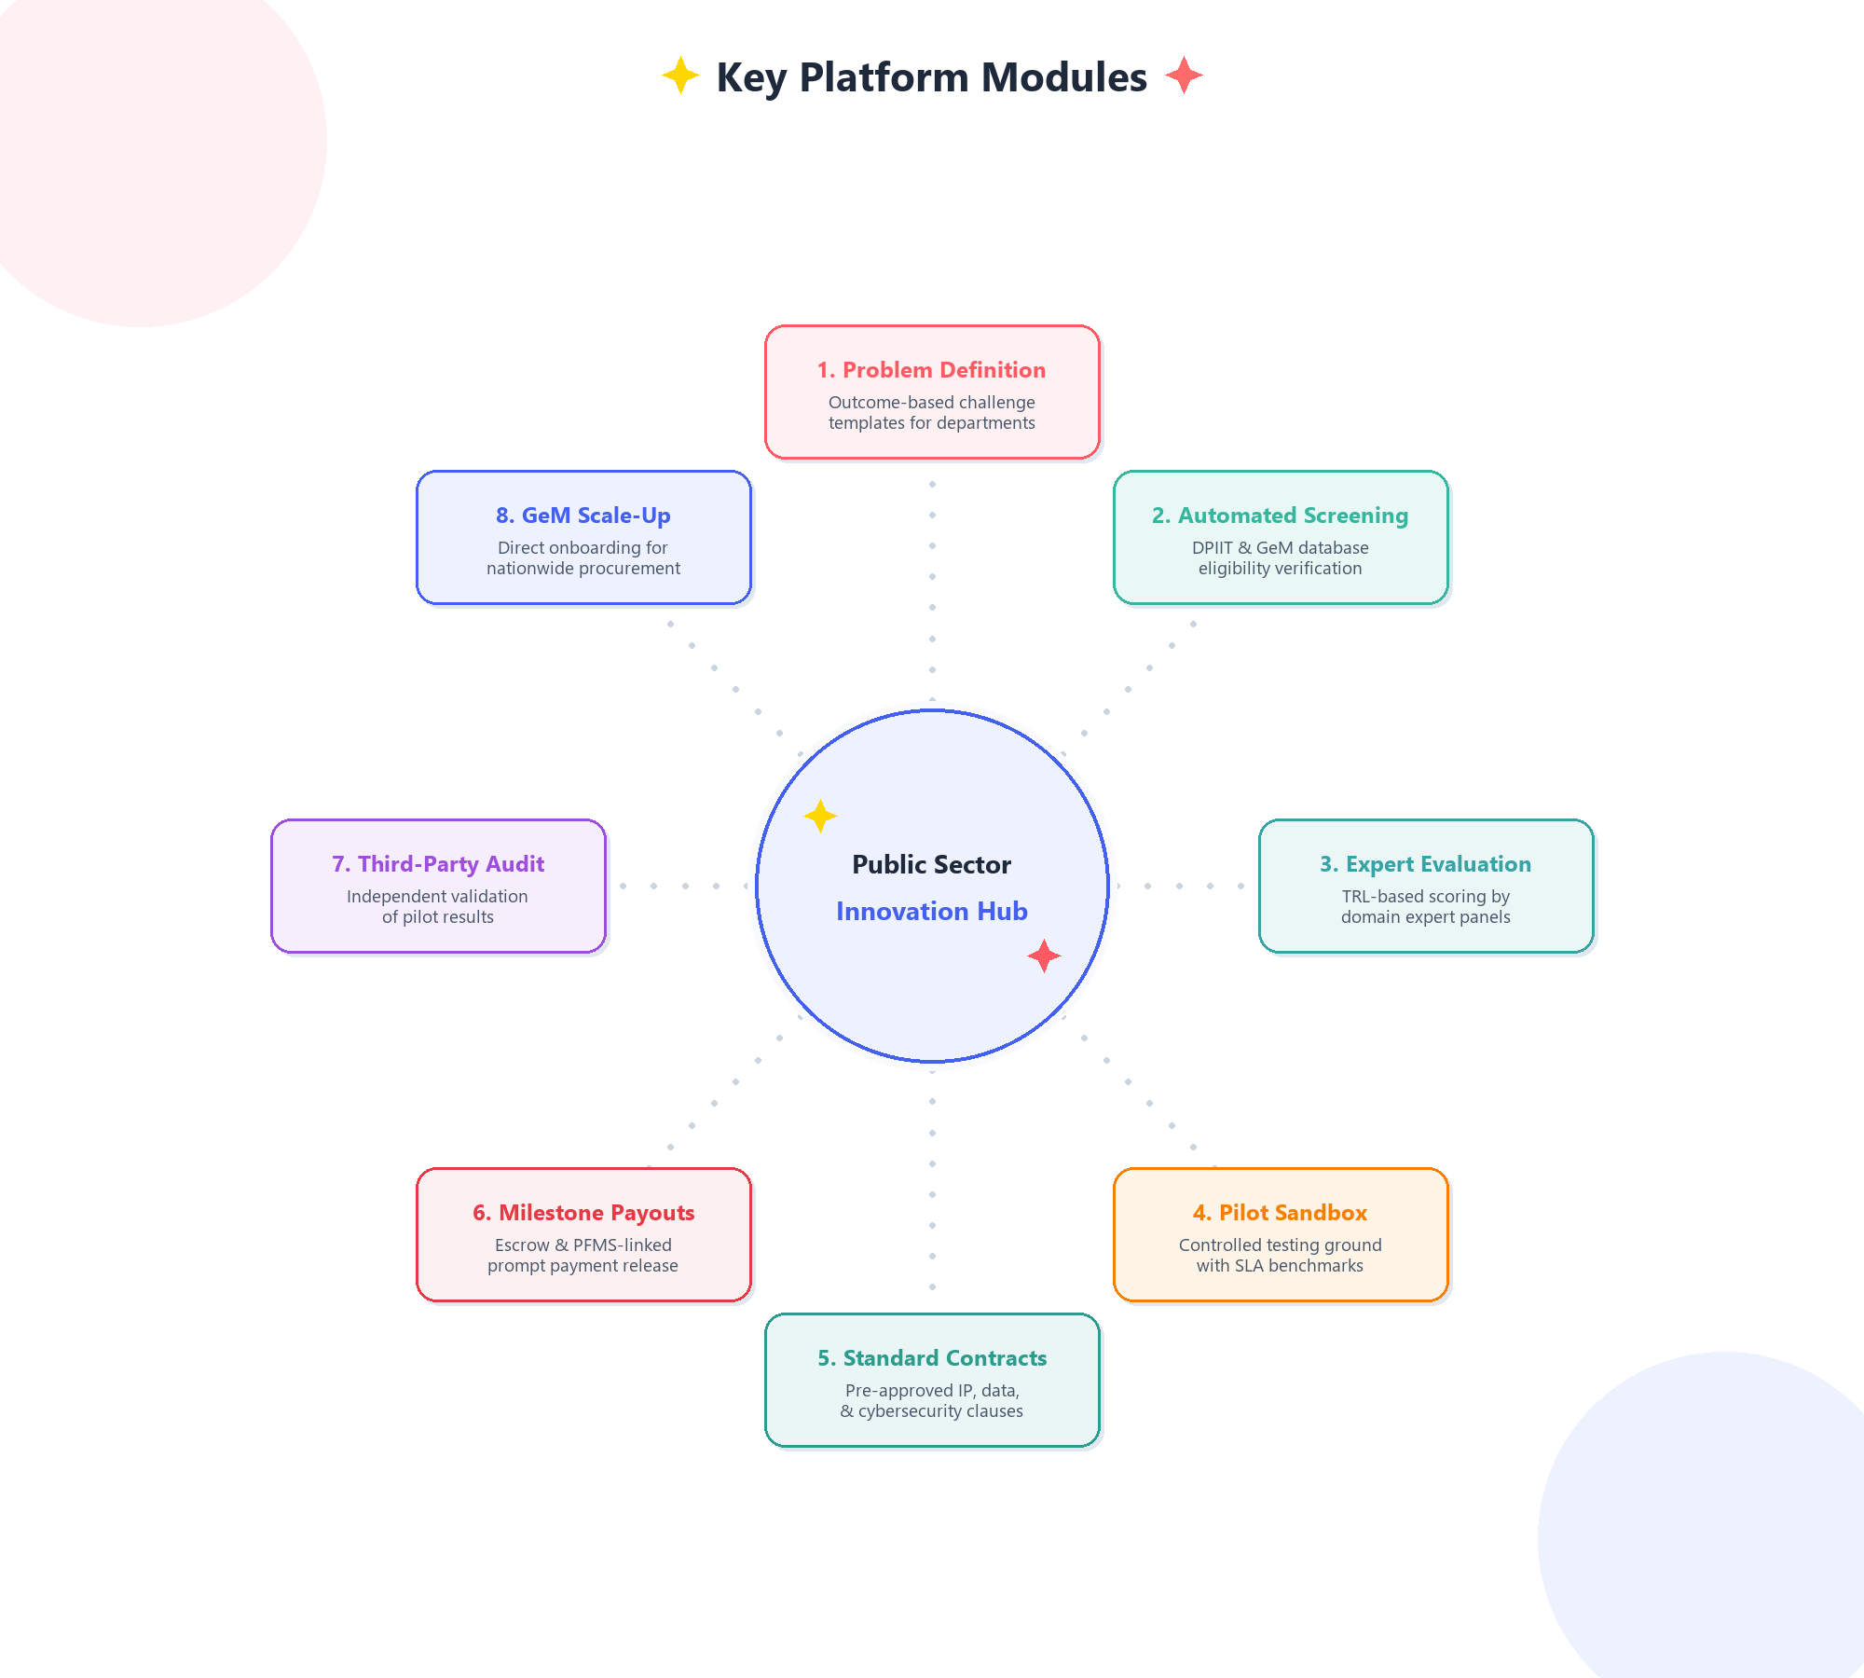
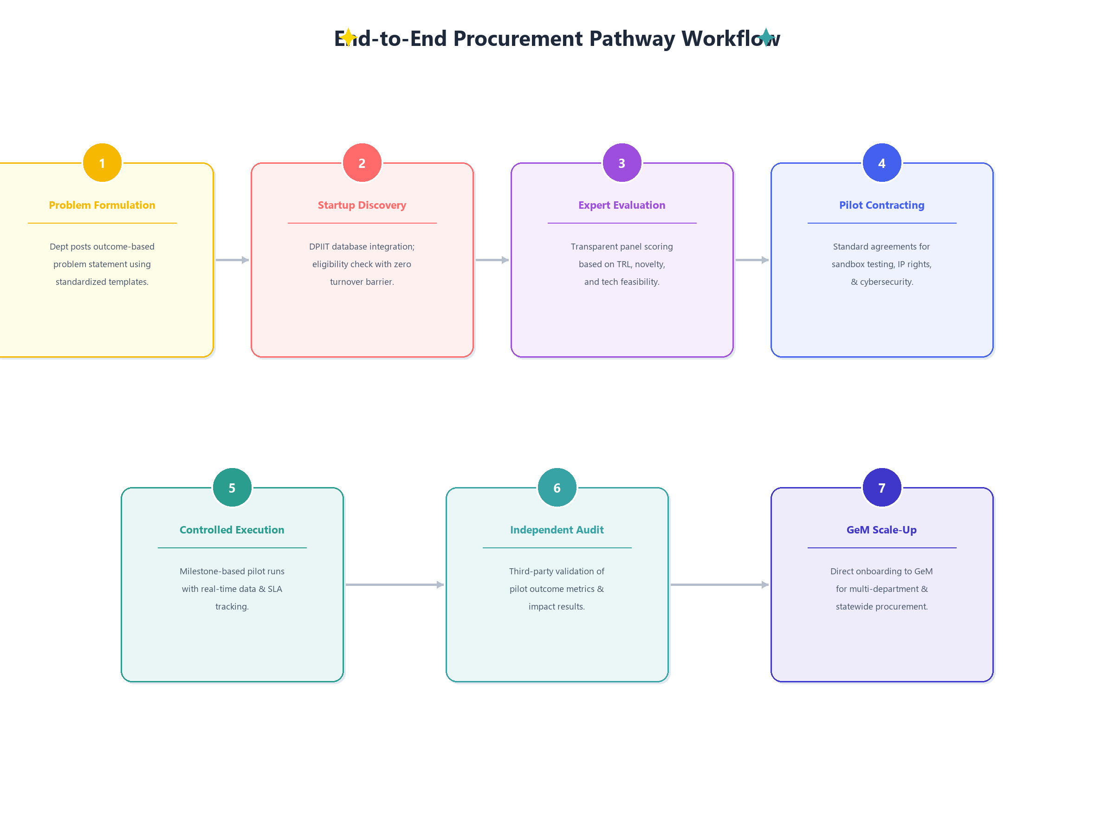
INNO-PROCURE PLATFORM
PEGASUS
Proposed Solution

Slide 3


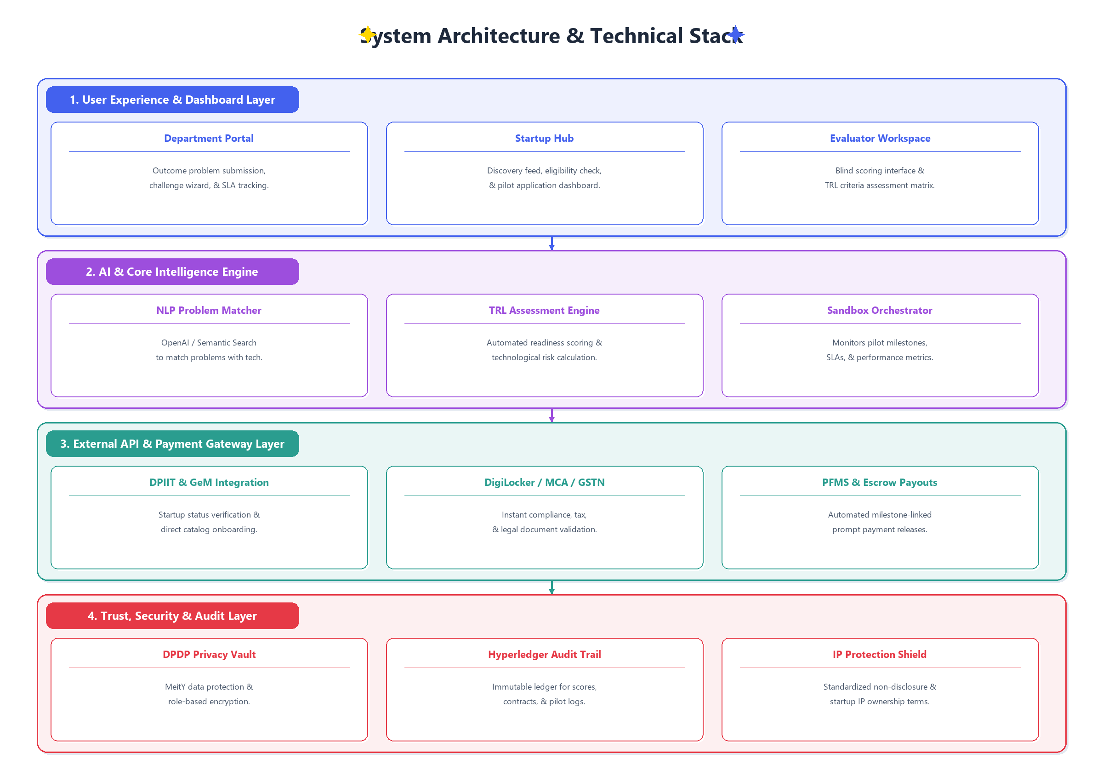

TECHNICAL APPROACH
PEGASUS
API / Platform Layer | Technical Role & Workflow Function
DPIIT Startup India API | Automated startup recognition verification & eligibility screening
Government e-Marketplace (GeM) API | Seamless onboarding & direct procurement cataloging for validated pilot solutions
DigiLocker / GSTN / MCA API | Instant legal verification of startup incorporation, compliance, & tax filings
PFMS / Bank Escrow API | Milestone-linked automated payment release & SLA-triggered payout dispatch
OpenAI / NLP Matching Engine | AI semantic matching engine to pair departmental problem statements with startup tech
Auth0 / Aadhaar eKYC API | Multi-factor authentication & role-based access for departments and evaluators
Grafana / D3.js Analytics | Real-time pilot execution dashboard, SLA tracking, & performance analytics
Hyperledger / Audit Trail Ledger | Tamper-proof immutable ledger for evaluation scores, IP terms, & milestone sign-offs

Slide 4
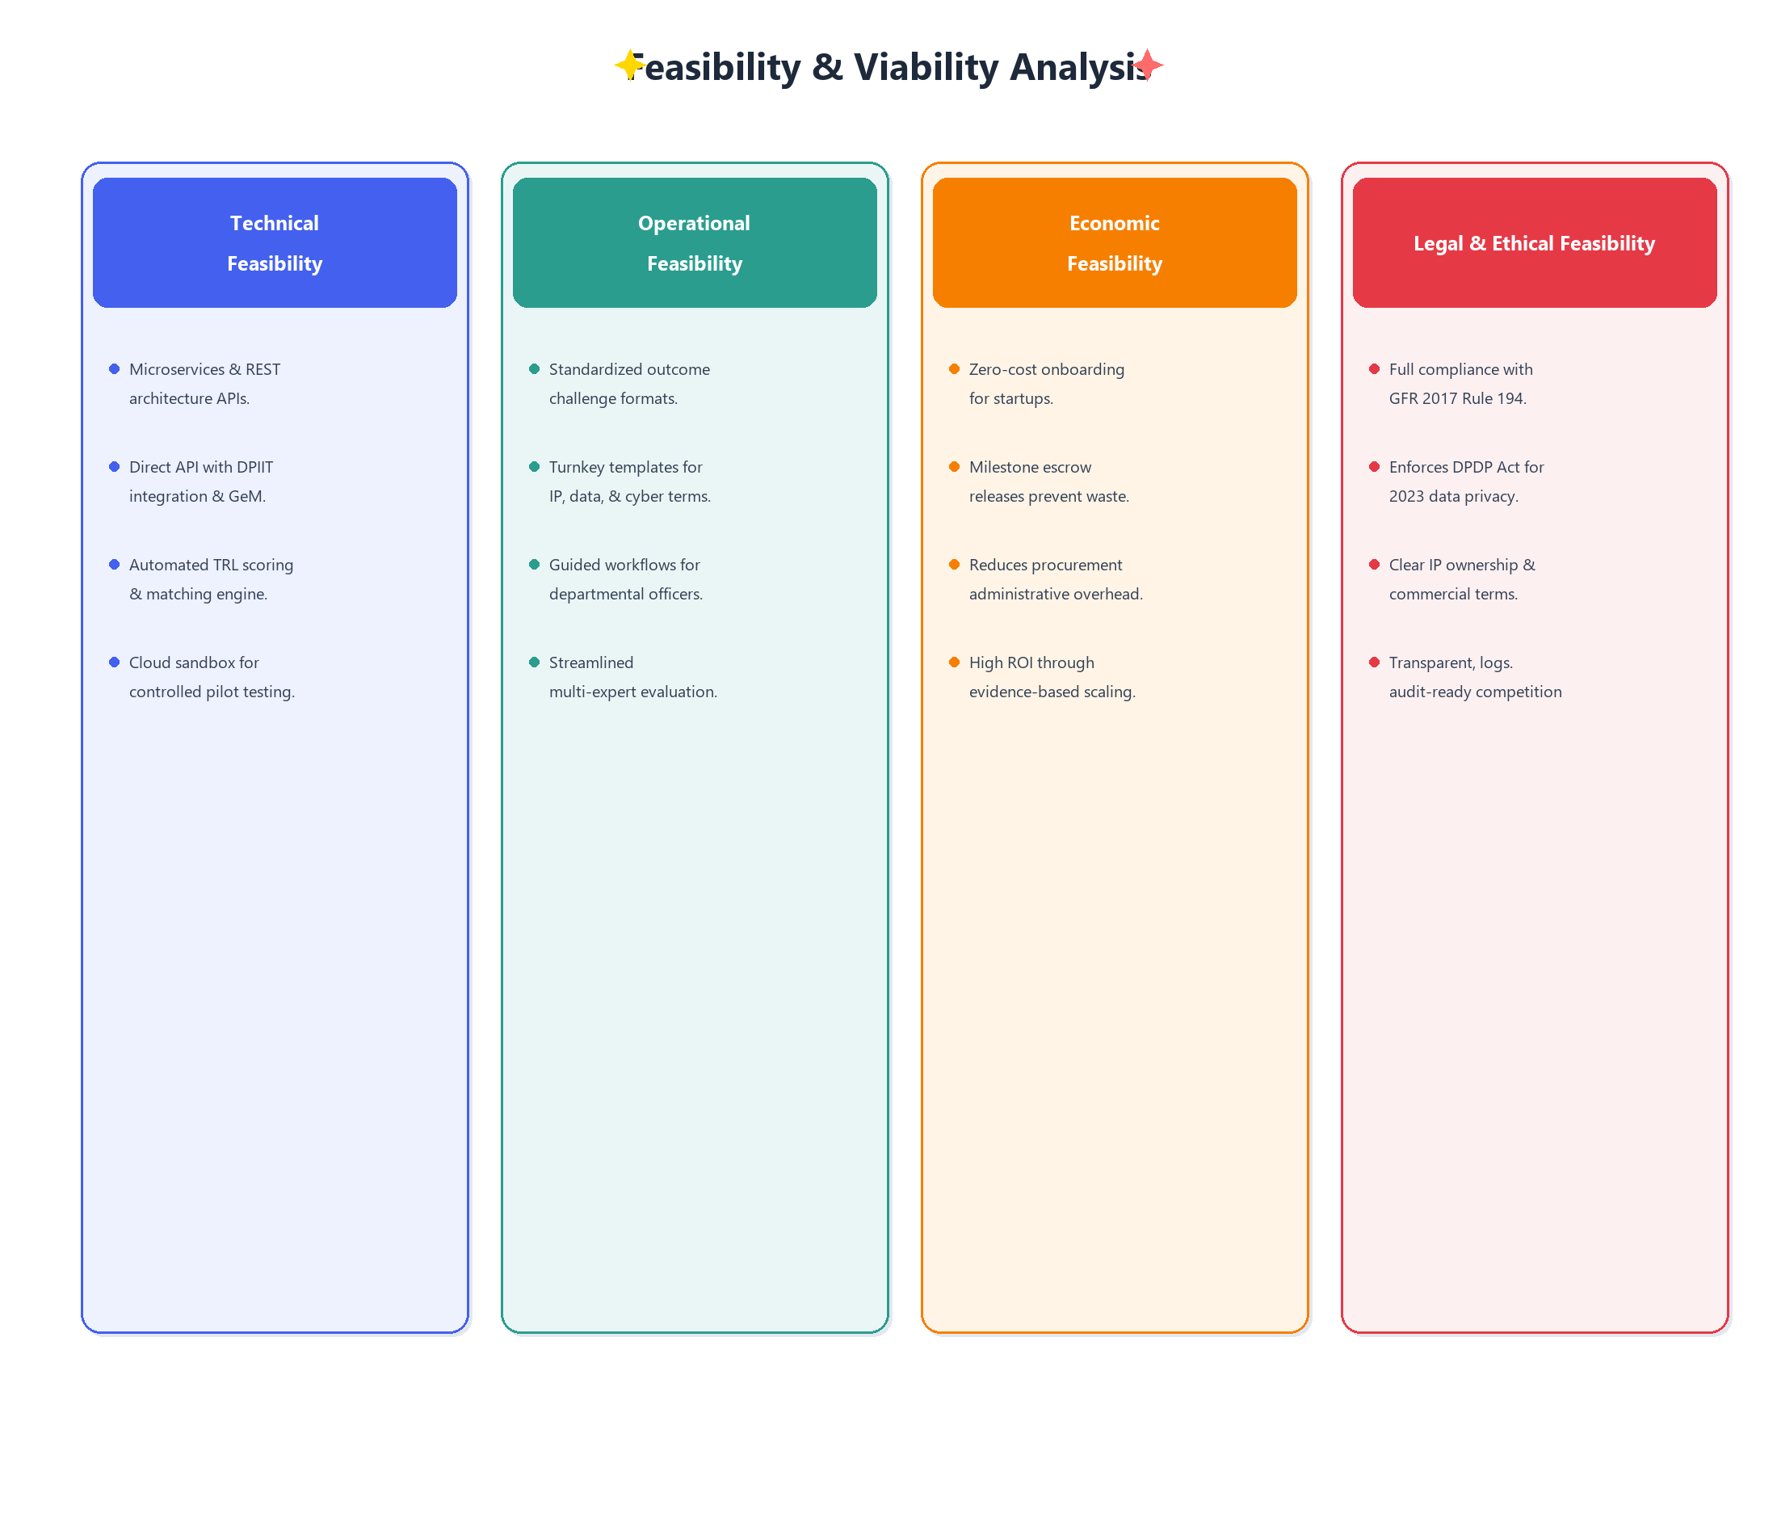
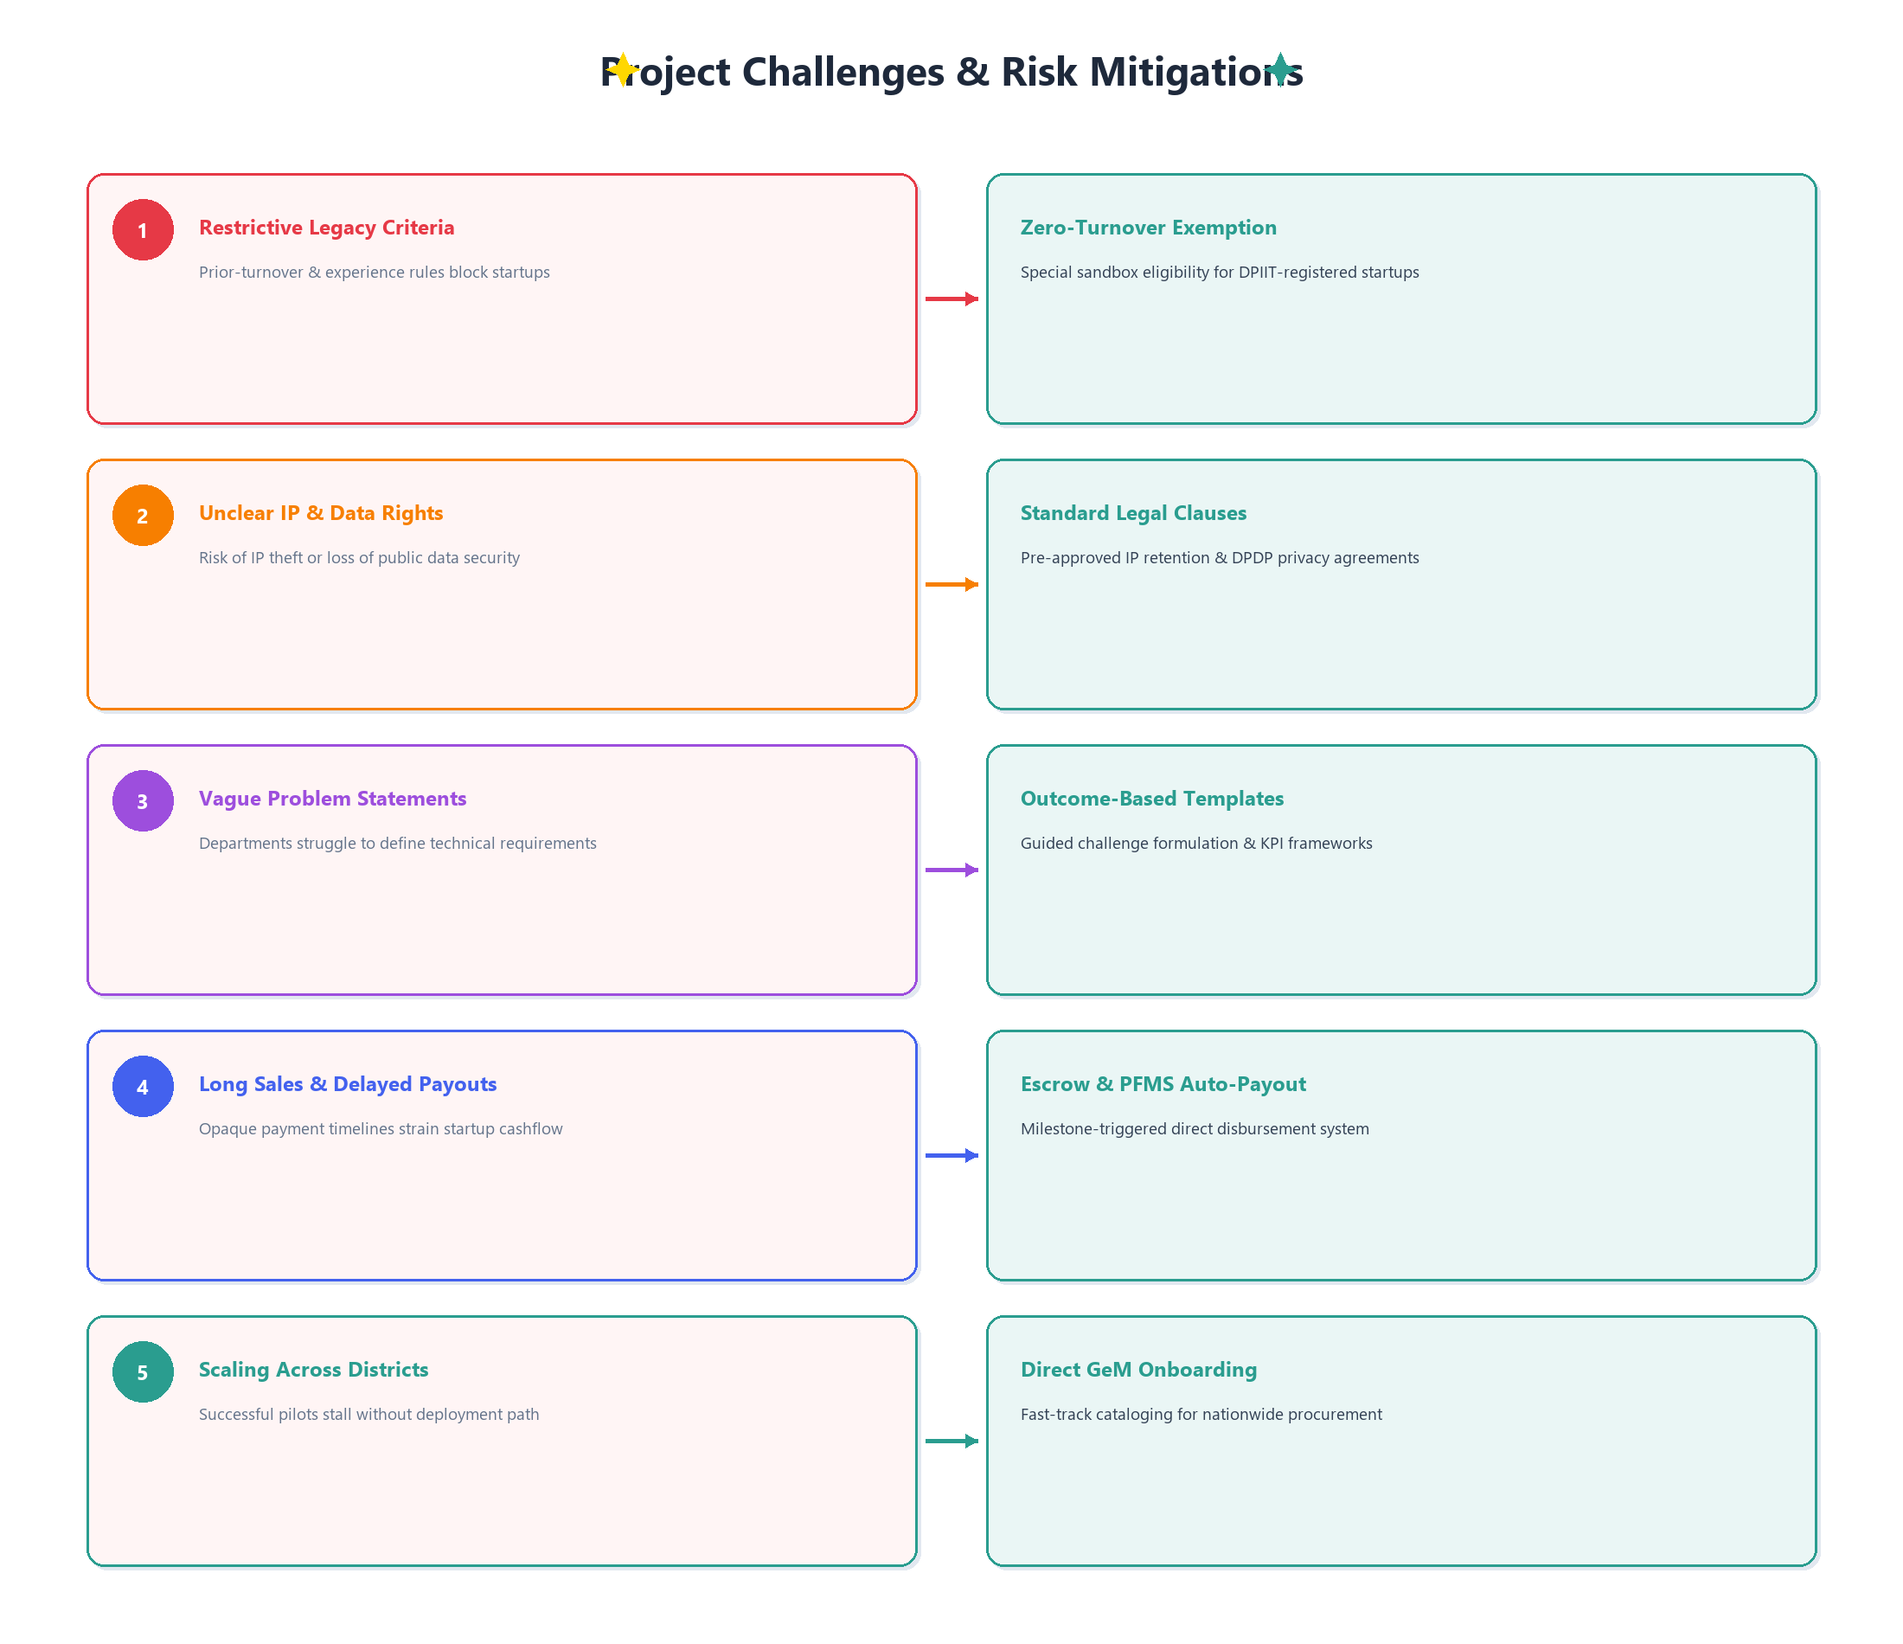
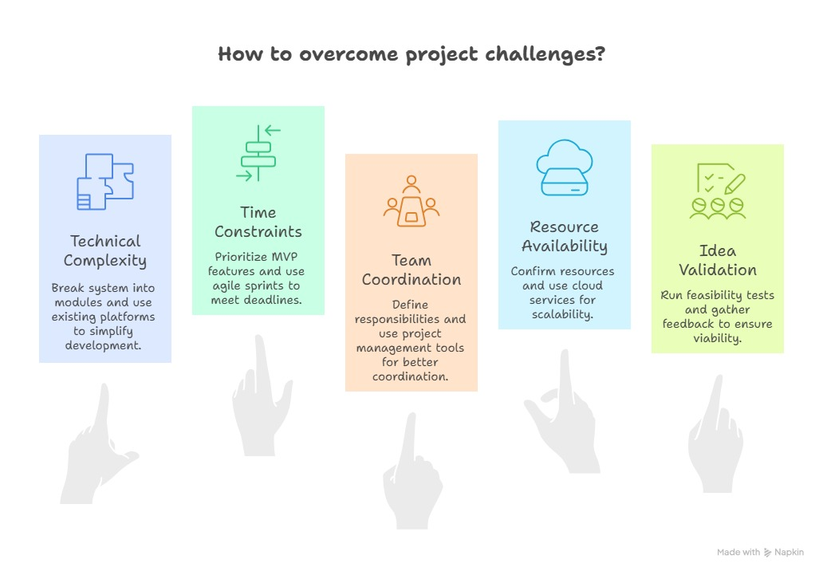
FEASIBILITY AND VIABILITY
PEGASUS

Slide 5
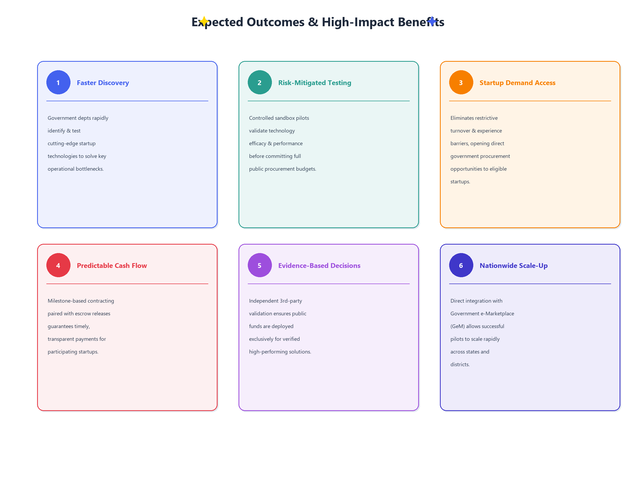
IMPACT AND BENEFITS
PEGASUS

Slide 6
RESEARCH AND REFERENCES
PEGASUS
DPIIT & Ministry of Commerce Guidelines - Public Procurement (Preference to Make in India) & Startup Innovation Procurement Frameworks.
General Financial Rules (GFR 2017) - Rule 194 & innovation procurement clauses for pilot testing & sandbox execution.
NITI Aayog Reports - "Unlocking Startup Potential in Public Procurement" & Technology Readiness Level (TRL) benchmarks.
Global GovTech Case Studies:
UK G-Cloud & GovTech Sandbox framework for early-stage vendor onboarding.
Singapore GovTech Procurement & Israel Innovation Authority public pilot models.
GeM & Data Security Standards - MeitY cybersecurity guidelines & DPDP Act 2023 compliance for public sector platforms.

Slide 7
IMPORTANT INSTRUCTIONS
Please ensure below pointers are met while submitting the Idea PPT:
Kindly keep the maximum slides limit up to six (6). ( Including the title slide)
Try to avoid paragraphs and post your idea in points /diagrams / Infographics /pictures
Keep your explanation precise and easy to understand
Idea should be unique and novel.
You can only use provided template for making the PPT without changing the idea details pointers (mentioned in previous slides).
You need to save the file in PDF and upload the same on portal. No PPT, Word Doc or any other format will be supported.
Note - You can delete this slide (Important Pointers) when you upload the details of your idea on SIH portal.

